Slide 1
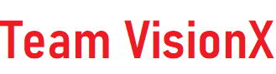
Bgsw-(bosch) AutovisionX hackathon home park assist team name –(team visionX) vikas saran bharat choudhary

Slide 2
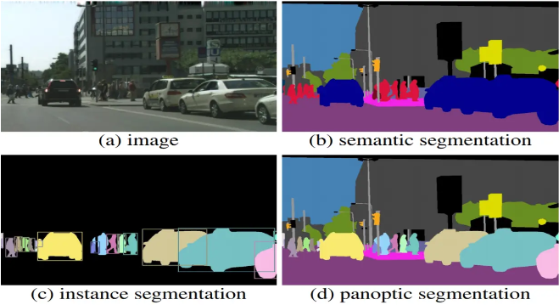
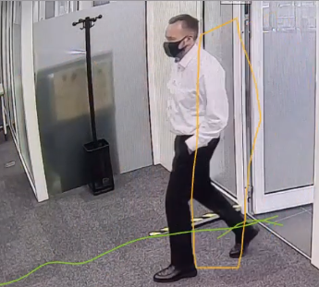


Areas of Interest
Overview
CNN(conventional neural networks) Panoptic segmentation (FCN&masked R-CNN) -> Aims to segment both "stuff" (e.g., roads, sky) and "things" (e.g., objects, people) -> Semantic segmentation (classifies each pixel into a category) and instance segmentation(detects and delineates each individual instance of an object). | 3
YOLO (you only look once) -> End-to-end neural network that makes predictions of bounding boxes -> Pre-trained YOLO model using OpenCV's DNN module.(YOLO tiny) BOSCH Video analytics(BOSCH security and safety systems) Centroid tracking Kalman filters Optical flow Thermal cameras outline mode(for more contrast with noise) | 4

Slide 3















Division of the projects into 3 majorities and solving problem efficiently
About tech-stacks
OpenCV modules(methods) | Memory Management | Deep Neural Networks (DNN)
Video Processing | Custom Allocation and Deallocation | Model Loading
Image Manipulation | Memory Map | Model Configuration
Background Subtraction | Total Memory Tracking | Input Processing
Contour Detection | free(ptr) Pointer Manipulation | Forward Pass/Post-processing
Drawing on Frames | Debugging and Optimization | Object Detection

Slide 4








OpenCV libraries used for the object detection
Evolution of the Project(solution)
1.
Raw video
2.
Frame differencing
3.
Background subtraction
4.
BitWise AND of frame differencing and background subtraction
5.
Object detection with DNN module

Slide 5
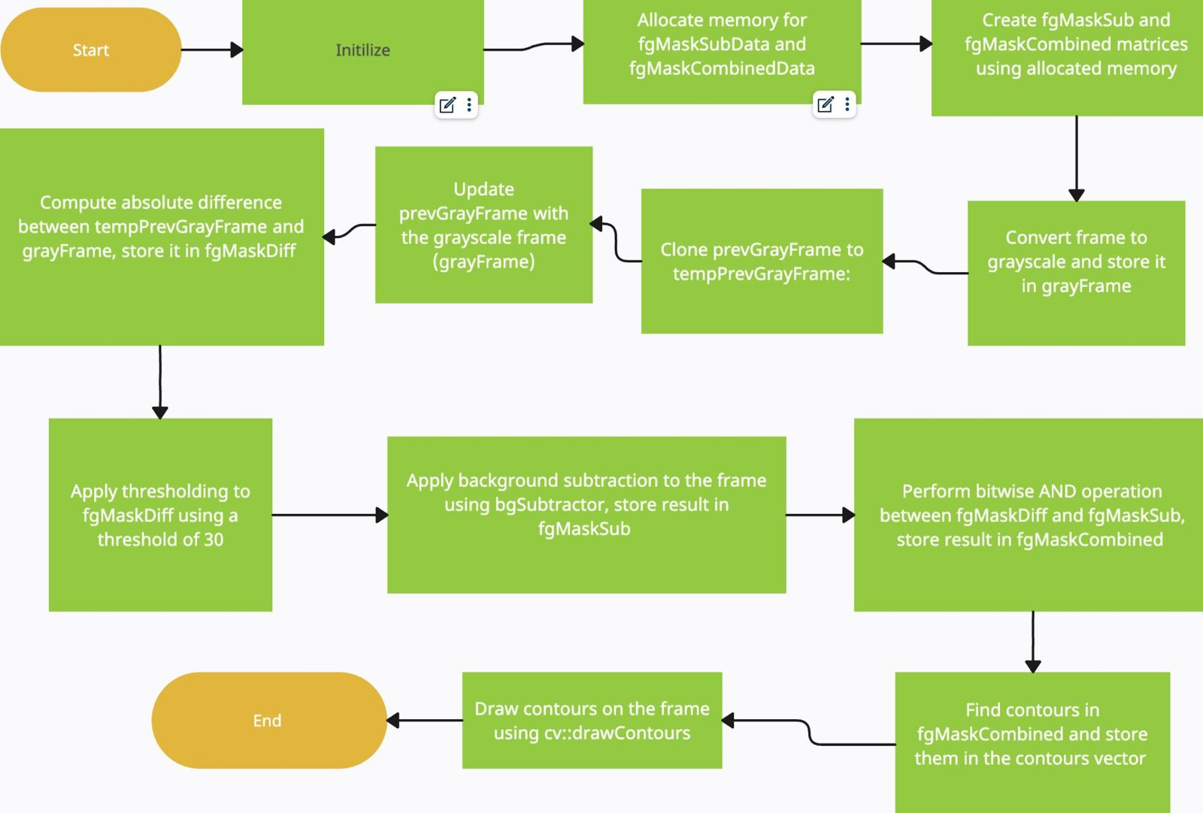

Image refinement and layout generation
Methodologies for outline generation
1.
Subtracting the pixel values of two consecutive frames in a video sequence, resulting in a difference image highlighting areas of motion or change. Thresholding is applied to the difference image to create a binary mask, which is then segmented to identify regions of interest.
2.
comparing each pixel in a video frame to a background model, identifying pixels with significant differences as foreground objects. A threshold is applied to create a binary mask highlighting foreground regions.

Slide 6
YOLO tiny v3 () vs semantic segmentation vs yolo embeded
Object detection using DNN module
semantic segmentation ()
Partition an image into meaningful regions and assign a class label to each pixel, effectively segmenting the image into different object categories.
Semantic segmentation models often employ deeper and more complex neural network architectures, such as U-Net, FCN (Fully Convolutional Network), or DeepLab, which may require higher computational resources for inference.
YOLO tiny v4 (80 classes) light-weight:
Realtime Application– particularly suited for resource-constrained environments like embedded systems
It operates on the entire image at once and provides precise localization of objects.
YOLO Tiny v3 utilizes a lightweight neural network architecture compared to the full version of YOLO, comprising fewer layers and parameters. This allows it to achieve real-time performance on devices with limited computational resources.
Yolo embedded(lighter than yolo tiny)

Slide 7
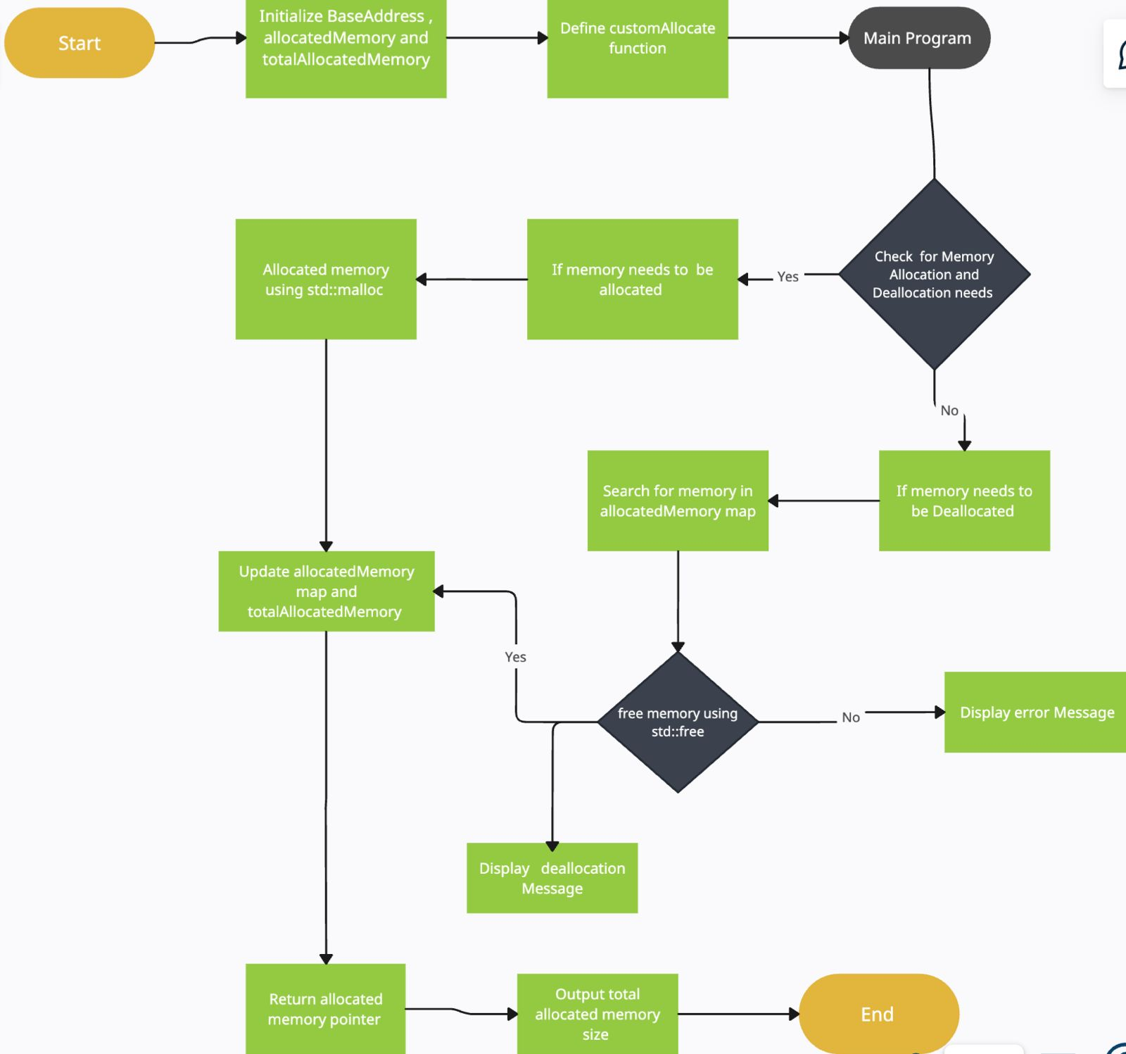

Custom allocator and deallocator
Memory management
1.
The project features custom memory management through defined functions to allocate and deallocate memory, tracking allocated memory blocks and sizes in a global map. Memory allocation is performed for various data structures, including strings, vectors, and integer counters, while deallocation occurs at the end of program execution. This approach ensures efficient memory usage and prevents memory leaks within the application.

Slide 8
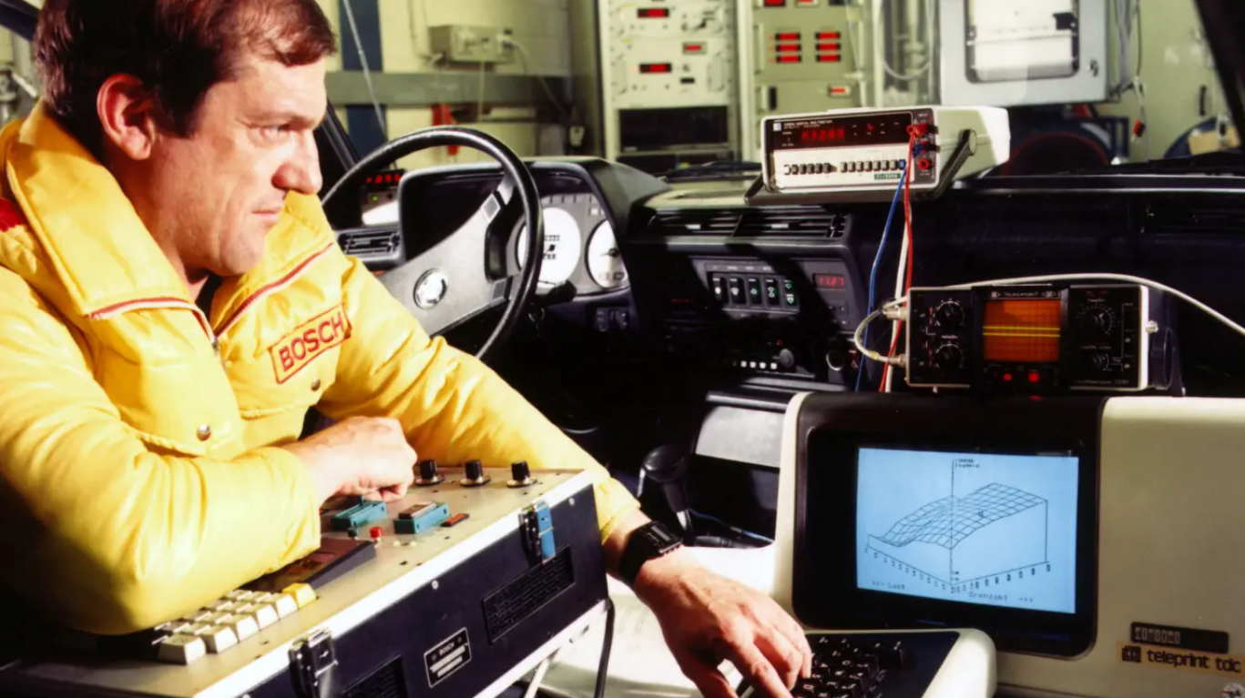
Motronic(a digital engine control system)1979.
Thank you

